Slide 1

UNIT – II INTRODUCTION TO C
FYBTECH
Subject : Computer Programming

Slide 2
Contents
Role of programming languages, Need to study programming languages, Characteristics of Programming Languages, Fundamentals of C-Programming - Character Set, Identifiers and keywords, Data types, Constants, Variables, Operators, Expression, statements, Library Functions, Pre-processor directives. Data Input and Output, Control Structures- Decision making,- if, if else, switch, Control Structures- Iterative- while ,do-while, for, break and continue statements, Structure of C program, Coding conventions.

Slide 3
Role of Programming Languages
A programming language is formal language that specifies a set of instructions that can be used to produce various kinds of output .
Programming languages generally consist of instructions for a computer .
Programming languages can be used to create programs that implement specific algorithms .

Slide 4
What is Programming Language
A programming language is a notational system for describing computation in machine-readable and human-readable form.
A programming language is a tool for developing executable models for a class of problem domains.

Slide 5
What is Programming Language
English is a natural language. It has words, symbols and grammatical rules.
A programming language also has words, symbols and rules of grammar.
The grammatical rules are called syntax.
Each programming language has a different set of syntax rules.

Slide 6
Steps in learning English Language-
Alphabets
Words
Sentences
Paragraph
Steps in learning C-Language-
Alphabets/
Digits/
Special Symbols
Constants/
Variables/
Keywords
Instructions
Program

Slide 7
Need to Study Programming Language
To improve your ability to develop effective algorithms.
To improve your use of existing programming languages.
To increase your vocabulary of useful programming constructs.
To allow a better choice of programming language.
To make it easier to learn a new language.
To make it easier to design a new language.

Slide 8
Characteristics of Programming Languages
The language must allow the programmer to write simple, clear and concise programs.
It must be simple to use so that a programmer can learn it without any explicit training.
It must be platform independent. That is, the program developed using the programming language can run on any computer system.
The Graphical User Interface (GUI) of the language must be attractive, user-friendly, and self-explanatory.
The function library used in the language should be well documented so that the necessary information about a function can be obtained while developing application.

Slide 9
Characteristics of Programming Languages (Cont…)
Several programming constructs supported by the language must match well with the application area it is being used for.
The programs developed in the language must make efficient use of memory as well as other computer resources.
The language must provide necessary tools for development, testing, debugging, and maintenance of a program. All these tools must be incorporated into a single environment known as Integrated Development Environment (IDE), which enables the programmer to use them easily.
The language must be consistent in terms of both syntax and semantics.

Slide 10
History and Features of C
Dennis Ritchie is the creator of C
Created at Bell Laboratories
Portable Language
C language is machine independent. Source Code written using C can be compiled on any machine(i.e. platform independant)
Structured Language
problem is solved using a divide and conquer approach

Slide 11
Constants
A Constant is a value that never changes during program execution.
Constants are given name and are referred by the given name.
Ex. PI=3.142

Slide 12
Variables
Hold the data in your program
A variable is an entity that can change during program execution
Rules for Variable Names
The first character in variable name must be an alphabet
No other special character except underscore is allowed
No blanks or commas are allowed
Variable names are case sensitive
Keywords cannot be used as variable names
Syntax : datatype varname;

Slide 13
Variables (cont’d)
Ex : int a; -----variable declaration int a=10----var definition
amount_in$ Which of these
2many variable names are
if valid ones?
iTotal

Slide 14
Program Structure
A sample C Program
#include<stdio.h>
int main()
{
int a;
--other statements
}

Slide 15
Header Files
The files that are specified in the include section is called as header file
These are precompiled files that has some functions defined in them
The functions can be called in the program by supplying parameters
Header file is given an extension .h
C Source file is given an extension .c

Slide 16
What is the purpose of header file in C?
A header file is a file with extension .h which contains C function declarations and macro definitions to be shared between several source files.
Header file is used in the program by including it, with the C preprocessing directive ' #include '.

Slide 17
Main Function
This is the entry point of a program
When a file is executed, the start point is the main function
From main function the flow goes as per the programmers choice.
There may or may not be other functions written by user in a program
Main function is compulsory for any c program

Slide 18
Writing the first program
#include<stdio.h> header file
int main() main function
{
printf(“Hello”);
return 0;
}
This program prints Hello on the screen when we execute it

Slide 19
Running a C Program
Type a program
Save it
Compile the program – This will generate an exe file (executable)
Run the program (Actually the exe created out of compilation will run and not the .c file)
In different compiler we have different option for compiling and running. We give only the concepts.

Slide 20
Comments
Comments are used to document programs and improve readability
In C a comment will start with /* and ends with */
Syntax: /* Comments */
/*This is a single line comment */
/* This is a multi line
comment in C */
/****************************************************
* This style of commenting is used for functions
****************************************************/
Only C style comments should be used

Slide 21
File Header Block
All source and header files must contain at the beginning of file, a section providing information about the source or the header file
• Format:
/*********************************************************
* File : <filename>
* Description : <description>
* Author : <author>
* Date : <Date>
*********************************************************/
File Footer Block
All files should have this footer at the end of the file
/*********************************************************
* End of <filename>
*********************************************************/

Slide 22
Indentation of Code
Indentation is the practice by Software Engineers to use spaces or tabs consistently in every line of code to group lines together based on their scope for easy readability
An indented code looks better and can be understood easily
The code in any line should not exceed 80 columns
Compiler and Linker Errors
If a program does not follow the syntax of a language then the compiler raises errors
Example: Missing semicolon
When the linker is not able to find a piece of code the linker errors are generated
Example: Variable or function referenced, but not defined anywhere in code

Slide 23
Data Types
Data types determine the following:
Type of data stored
Number of bytes it occupies in memory
Range of data
Operations that can be performed on the data
C supports the following data types:
int – for storing whole numbers
char – for storing character values, represents a single character
float – for storing fractional values
double – for storing fractional values
Note: float can store up to 6 digits of precision
double can store up to 12 digits of precision

Slide 24
C supports the following modifiers along with data types:
short
long
signed
unsigned

Slide 25
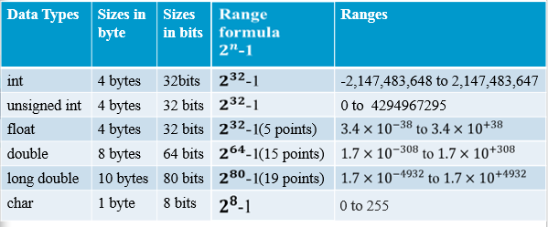
Range of Data Types
Note: Number of bytes and range given to each data type is platform dependent

Slide 26
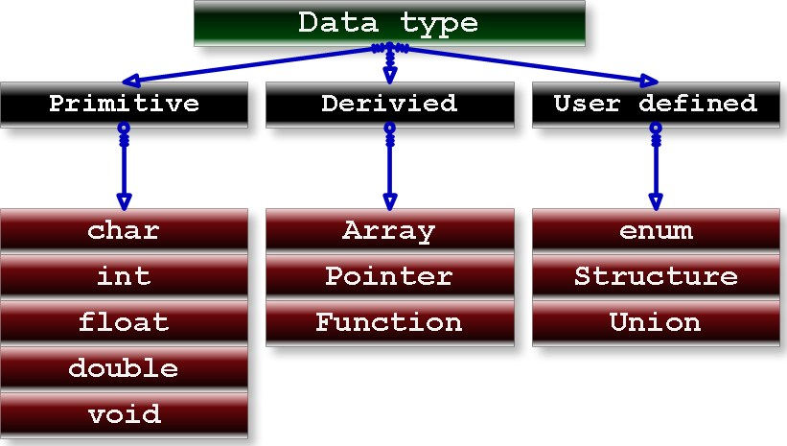
Data Types in C

Slide 27
Variables
Variables are data that will keep on changing
Declaration
<<Data type>> <<variable name>>;
int a;
Definition
<<varname>>=<<value>>;
a=10;
Usage
<<varname>>
a=a+1; //increments the value of a by 1

Slide 28
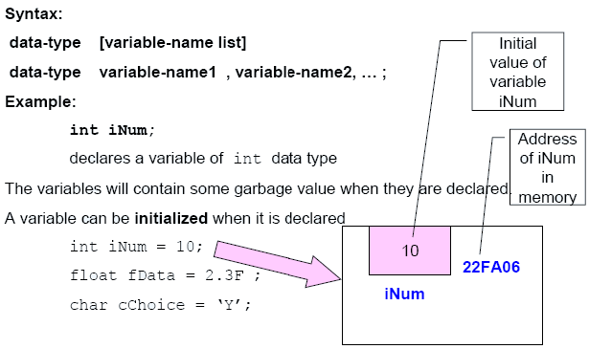
Declaration of Variables

Slide 29
Keywords
Keywords are predefined, reserved words used in programming that have special meanings to the compiler.
Keywords are part of the syntax and they cannot be used as an identifier.

Slide 30
Standard ANSI C Keywords
auto break case char const continue default do double else enum extern float for goto volatile
if int long register return short signed sizeof static struct switch typedef union unsigned void while

Slide 31
Identifiers
Identifiers are names for entities in a C program, such as variables, arrays, functions, structures, unions and labels.
An identifier can be composed only of uppercase, lowercase letters, underscore and digits, but should start only with an alphabet or an underscore.

Slide 32
Rules for constructing identifiers
The first character in an identifier must be an alphabet or an underscore and can be followed only by any number alphabets, or digits or underscores.
They must not begin with a digit.
Uppercase and lowercase letters are distinct. That is, identifiers are case sensitive.
Commas or blank spaces are not allowed within an identifier.
Keywords cannot be used as an identifier.
Identifiers should not be of length more than 31 characters.
Identifiers must be meaningful, short, quickly and easily typed and easily read.
Valid identifiers: total sum average _x y_ mark_1 x1
Invalid identifiers: 1x -> It begins with a digit char -> It is reserved word x+y -> It is a special character

Slide 33
Operators In C
Assignment operator ( = )
Arithmetic operators ( +, -, *, /, % )
Relational operators ( >, >=, <, <=, == , != )
Logical operators ( !, &&, || )
Address operator ( & )
Increment and Decrement operators ( ++, -- )
Compound Assignment Operators ( =, +=, -=, /=, *=, %= • )
sizeof operator

Slide 34
Use of Modulus (%) Operator
Used to find the remainder after integer division
The operands that are supplied to this operator should always be integers
The operator returns an integer value
Using ‘float’ for any of the operands will result in a compiler error
Example:
Remainder = Number % 4 ;
If the variable ‘Number’ has a value 21, then the resultant value in ‘Remainder’ will be 1

Slide 35
Type Casting
Temporary conversion of one data type into another.
In some situations, the compiler will automatically convert one data type into another.
Example:
float Result;
Result = 7 / 2 ;
The variable Result will store 3.0 instead of 3.5
To get the ‘float’ value, the expression should be:
Result = 7.0 / 2; or
Result = 7 / 2.0; or
Result = 7.0 / 2.0; or
Result = (float) 7 / 2; or
Result = 7 / (float) 2;

Slide 36
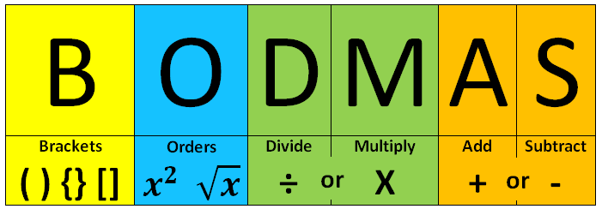
Precedence of Arithmetic Operators
Operator Priority * , / and % Highest + and - Lowest The expression that is written within parenthesis is given highest priority
Evaluate the following expression:
Using a = 5, b = 3, c = 8 and d = 7
b + c / 2 – (d * 4) % a
b + c / 2 – 28 % a
b + 4 – 28 % a
b + 4 – 3
7 – 3
4

Slide 37
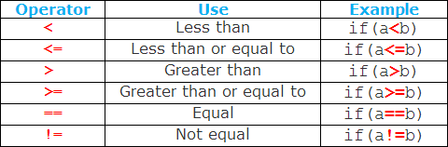
Relational Operators
Used to compare two values and also called as comparison operators
Expressions that contain relational operators are called as relational expressions
A relational operator returns either zero or a non-zero value
If the expression is true then it returns a non-zero value (>0)
If the expression is false then it returns zero
•Example:
1500 > 700 returns 1 (true)
1500 < 700 returns 0 (false)

Slide 38
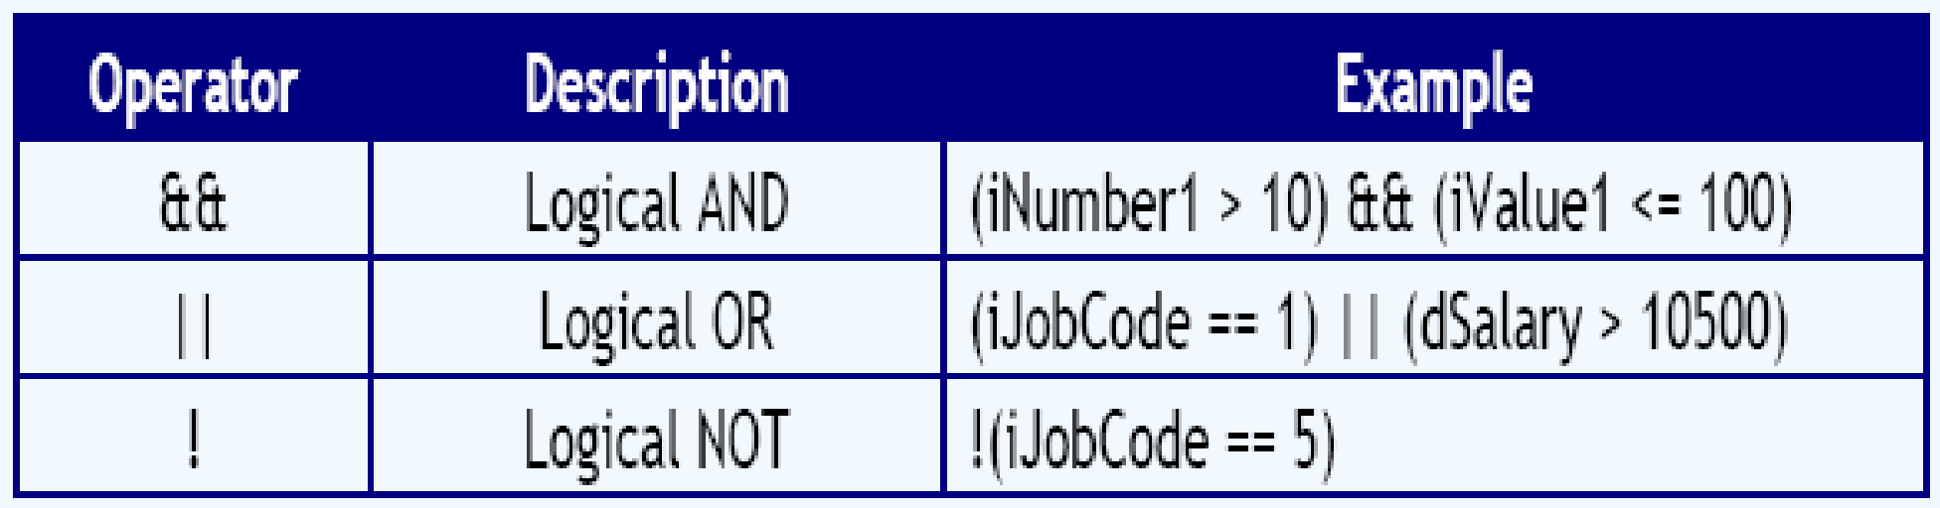
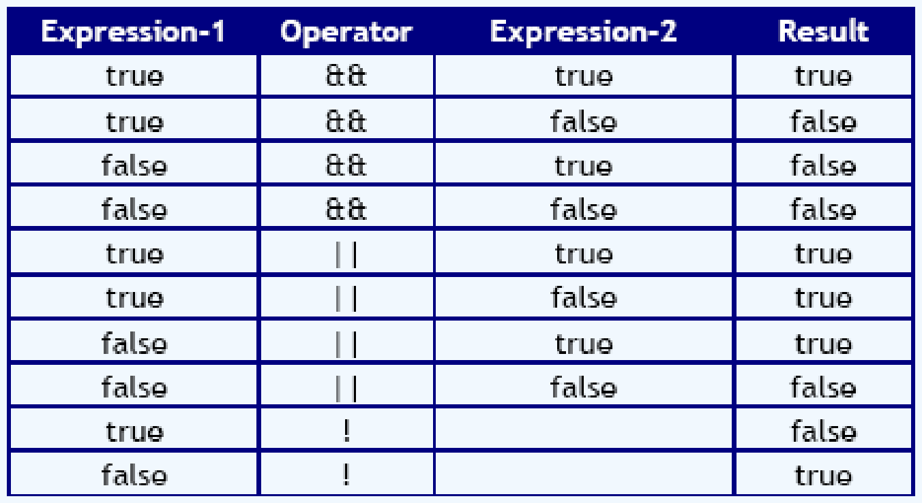
Logical Operators
Used to combine two or more relational expressions
An expression involving logical operators is called as a logical expression

Slide 39
Increment and Decrement Operators
Operators ++ and -- are called as increment and decrement operators
These operators increment or decrement the variable’s value by 1
They are also called as unary operators because they have only one operand to operate
If the operator is used before the operand, it is prefix and if the operator is used after the operand, it is postfix
Example:
++ Value and -- Value is called as prefix
Value++ and Value-- is called as postfix

Slide 40
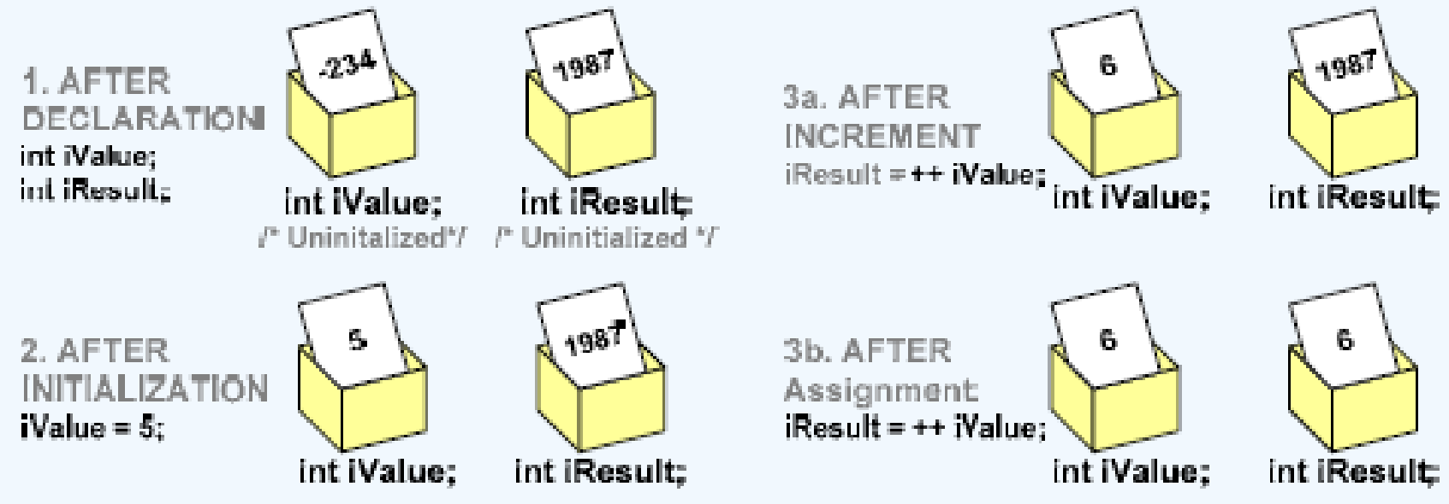
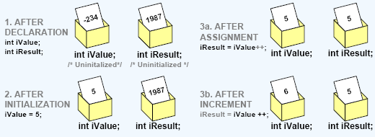
Difference Between Prefix and Postfix
Prefix operator first increments / decrements and then makes the assignment
Example:
int iValue;
int iResult;
iValue = 5;
iResult = ++iValue;
Post fix operator makes the assignment and then increments/decrements the
Value
Example:
int iValue;
int iResult;
iValue = 5;
iResult = iValue++;

Slide 41
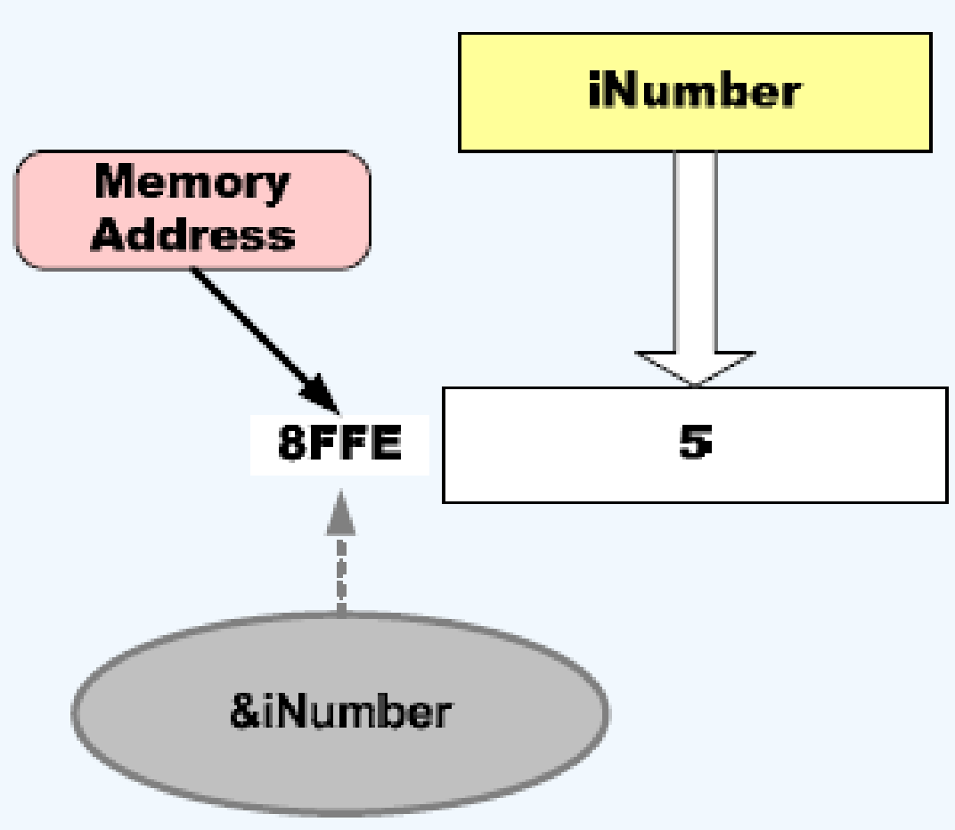
Address of Operator
Ampersand (&) is the “address of” operator
It is used to fetch the memory address of a variable

Slide 42
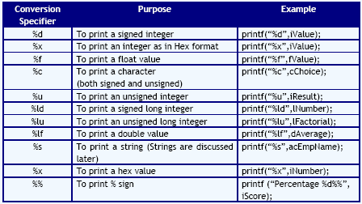
Formatted Output Using printf
Writes onto screen (standard output)
Syntax
printf(“Conversion Specifier-list”,variable-1, variable-2,…………………);

Slide 43
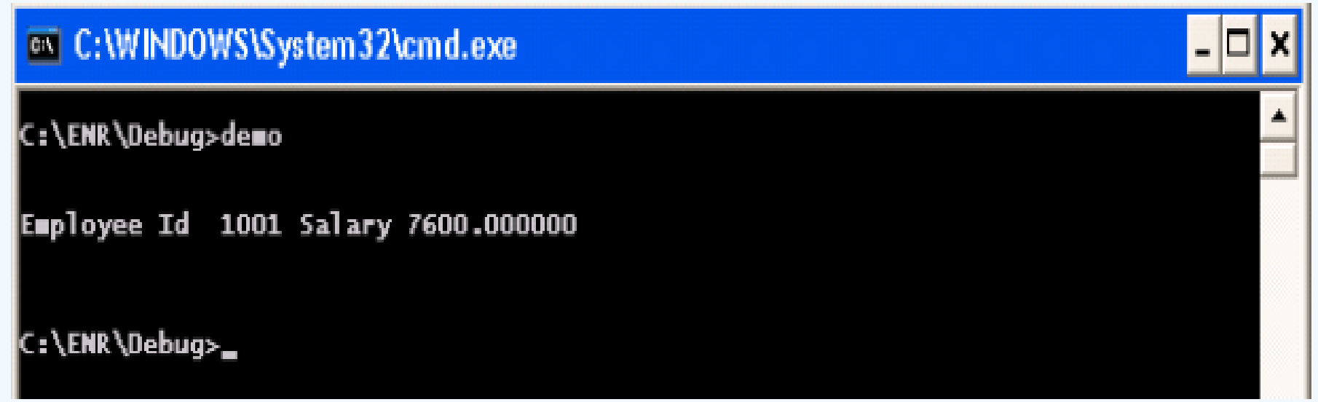
Formatted Output Using printf (cont’d)
Example:
int EmployeeId = 1001;
double Salary = 7600.00;
printf(“Employee Id %d” , EmployeeId);
printf(“Salary %lf”, Salary);

Slide 44
Scanf( )
Read input from screen (standard input)
Syntax
scanf(“format Specifier-list”,&variable-1, &variable-2,…………………);
Example
void main()
{
int a;
printf(“Enter a number”);
scanf(“%d”,a);
}

Slide 45
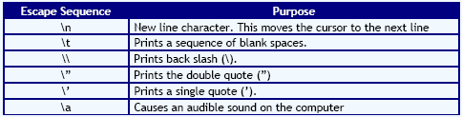
Formatted Output Using printf (cont’d)
An escape sequence is interpreted to have a special meaning in the screen output
All the escape sequences must be preceded by a back slash (\)
Escape sequences are non printable characters
Escape sequences are generally used with ‘printf’ function

Slide 46
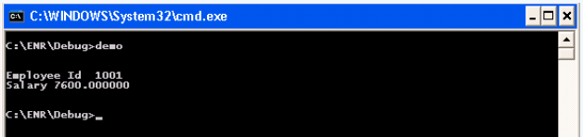
Formatted Output Using printf (cont’d)
Example:
int EmployeeId = 1001;
double Salary = 7600.00;
printf(“Employee Id %d\n“, EmployeeId);
printf(“Salary %lf\n”, Salary);

Slide 47
Declaring and Using Character Variables
Syntax:
char variablename1, variablename2,….;
Example:
char Alphabet;
char Status, Number ;
The value can be assigned by enclosing it in a single quote (‘ ‘)
Example:
Alphabet = ‘W’;
Status = ‘y’;
A character variable can be assigned with a numeric value by directly assigning a number
Example:
Number = 77;
The above statement can also be written as Number = ‘M’;

Slide 48
The ASCII Character Set
Character data is represented in a computer by using standardized numeric codes which have been developed.
The most widely accepted code is called the American Standard Code for Information Interchange ( ASCII).
The ASCII code associates an integer value for each symbol in the character set, such as letters, digits, punctuation marks, special characters, and control characters.
ASCII value for capital A is 65, B is 66,………., Z is 90.
ASCII value for small a is 97, b is 98,…………, z is 122.

Slide 49
Printing a character on screen
For printing characters, ‘%c’ conversion specifier is used in ‘printf’
Example:
char Alphabet = ‘N’;
printf (“%c”, Alphabet);
The above code is same as:
char Alphabet = 78;
printf (“%c”, Alphabet);

Slide 50
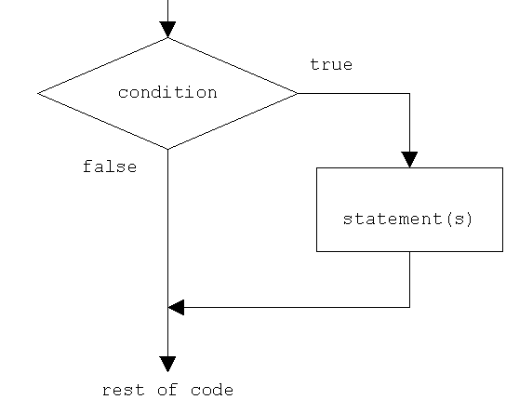
Control Structures
Selectional Control Structures
There are two selectional control structures
If statement
Switch statement
Simple if Statement
In a simple ‘if’ statement, a condition is tested
If the condition is true, a set of statements are executed
If the condition is false, the statements are not executed and the program
control goes to the next statement that immediately follows if block
Example
if (Duration >= 3)
{ RateOfInterest = 6.0; }

Slide 51
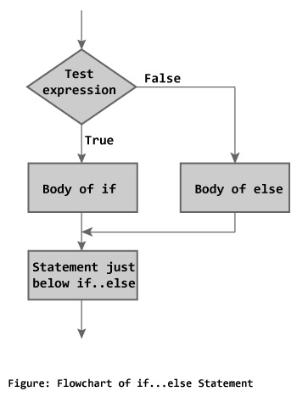
else Statement
else Statement
In simple ‘if’ statement, when the condition is true, a set of statements are executed. But when it is false, there is no alternate set of statements
The statement ‘else’ provides the same
Syntax:
if (testExpression)
{
// codes inside the body of if
}
else
{
// codes inside the body of else
}

Slide 52
else Statement (Cont’d)
else Statement
Example:
if (Duration >= 3) {
RateOfInterest = 6.0;
}
else {
RateOfInterest = 5.5;
}
else if Statement
The ‘else if’ statement is to check for a sequence of conditions
When one condition is false, it checks for the next condition and so on
When all the conditions are false the ‘else’ block is executed
The statements in that conditional block are executed and the other ‘if’ statements are skipped

Slide 53
Nested if Statement
Syntax: if (condition-1)
{
Statement 1;
if (condition-2)
{
Statement 2;
}
else
{ Statement n;
}
}
else { Statement x; } Next Statement;
Nested if Statement
• An ‘if’ statement embedded within another ‘if’ statement is called as nested ‘if’
• Example:
if (iDuration > 6 )
{
if (dPrincipalAmount > 25000)
{
printf(“Your percentage of incentive is 4%”);
}
else
{
printf(“Your percentage of incentive is 2%”);
}}
else {
printf(“No incentive”);
}

Slide 54
Example
/* Program to check whether an integer entered by the user is odd or even */
#include <stdio.h>
int main()
{
int number;
printf("Enter an integer: ");
scanf("%d",&number);
/* True if remainder is 0*/
if( number%2 == 0 )
printf("%d is an even integer.",number);
else
printf("%d is an odd integer.",number);
return 0;
}

Slide 55
switch case Statement
The ‘switch’ statement is a selectional control structure that selects a choice from the set of available choices.
It is very similar to ‘if’ statement.
But ‘switch’ statement cannot replace ‘if’ statement in all situations.
Syntax:
switch (n)
{
case 1: // code to be executed if n = 1;
break;
case 2: // code to be executed if n = 2;
break;
default: // code to be executed if n doesn't match any cases
}

Slide 56
switch case Example
/*Following is a simple program to demonstrate syntax of switch.
#include <stdio.h>
void main()
{
int x = 2;
switch (x)
{
case 1: printf("Choice is 1");
break;
case 2: printf("Choice is 2");
break;
case 3: printf("Choice is 3");
break;
default: printf("Choice other than 1, 2 and 3");
break;
}
}
Output: Choice is 2

Slide 57
Iterational Control Structures
Iterational (repetitive) control structures are used to repeat certain statements for a specified number of times
The statements are executed as long as the condition is true
These kind of control structures are also called as loop control structures
Three kinds of loop control structures are:
while
do while
for

Slide 58
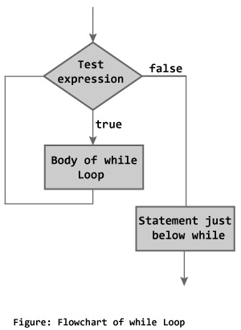
while Loop Control Structure
A ‘while’ loop is used to repeat certain statements as long as the condition is true
When the condition becomes false, the ‘while’ loop is quitted
This loop control structure is called as an entry-controlled loop because, only when the condition is true, are the statements executed
Syntax:
while (condition)
{
Set of statements;
}
Next Statement;
Example:
unsigned int Count = 1;
while (Count <= 3) {
printf(“%d\n”,Count);
}

Slide 59
What is the output of the following code?
Example 2
int Count = 1;
while(Count<=10)
{
printf(“\n MITCOE”);
Count++;
}
Example 1
unsigned int Count=3;
while (Count<=5)
{
printf(“%u\n”,Count);
Count++;
}

Slide 60
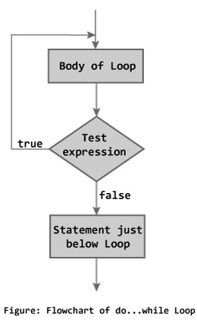
do while Loop Control Structure
The ‘do while’ loop is very similar to ‘while’ loop. In ‘do while’ loop, the condition is tested at the end of the loop.
Because of this, even when the condition is false, the body of the loop is executed at least once.
This is an exit-controlled loop.
Syntax:
do
{
Set of statement(s);
} while (condition);
Next Statement;

Slide 61
do while Loop Control Structure Example
int Number, Sum = 0;
do {
printf(“Enter a number. Type 0(zero) to end the input ”);
scanf(“%d”,&Number);
Sum = Sum + Number;
} while (Number != 0);

Slide 62
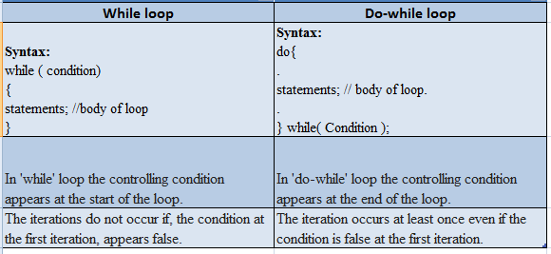
Difference between while and do while loops

Slide 63
for Loop Control Structure
The ‘for’ loops are similar to the other loop control structures
The ‘for’ loops are generally used when certain statements have to be executed a specific number of times
Advantage of for loops:
All the three parts of a loop (initialization, condition , increment) can be given in a single statement
Because of this, there is no chance of user missing out initialization or increment steps which is the common programming error in ‘while’ and ‘do while’ loops
Syntax:
for (Initialization; Termination-Condition; Increment-Step)
{
Set of statement(s);
}
Next Statement;

Slide 64
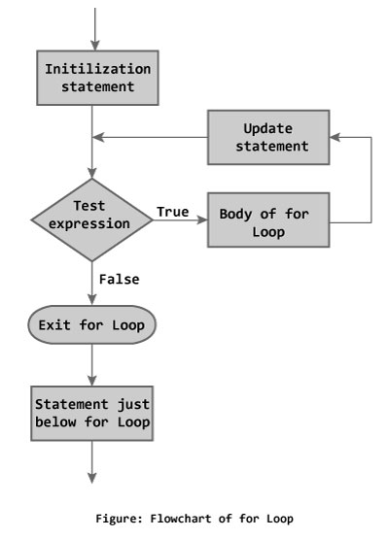
for Loop Control Structure (cont’d)
Example:
int Count;
for (Count = 1; Count <= 5; Count++)
{
printf(“%d\n”,Count);
}
Output: 1
2
3
4
5

Slide 65
What is the output of the following code?
int Num;
int Counter;
int Product;
for(Counter=1; Counter<= 3; Counter++)
{
Product = Product * Counter;
}
printf("%d", Product);
The output is a junk value -- WHY???

Slide 66
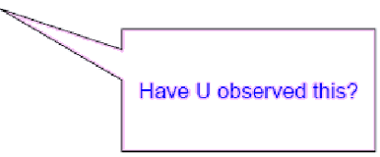
What is the output of the following code?
for(Count=0;Count<10;Count++);
{
printf("%d\n",Count);
}
The output is 10

Slide 67
for and while loops
Given
for(Sum=0,Ctr=0;Ctr<10;Ctr=Ctr+1)
{
scanf(“%d”,&Num);
Sum=Sum+Num;
}
printf(“%d”,Sum);
Rewrite it using while statement
Sum=0,Ctr=0;
while(Ctr<10)
{
scanf(“%d”,&Num);
Sum=Sum+Num;
Ctr=Ctr+1;
}
printf(”%d”,Sum);

Slide 68
Nested Loops
A loop with in another loop is called as nested loop.
Example:
while (flag==1)
{
for (Count=1;Count<=10;Count++)
{
statements;
}
}

Slide 69
Quitting the Loops – break Statement
The break statement is used to:
Force the termination of a loop.
When a break statement is encountered in a loop, the loop terminates immediately and the execution resumes the next statement following the loop.
Note:
Break statement can be used in an if statement only when the if statement is written in a loop
Just an if statement with break leads to compilation error in C

Slide 70
What is the output of the following code?
int Counter1=0;
int Counter2;
while(Counter1 < 3) {
for (Counter2 = 0; Counter2 < 5; Counter2++) {
printf("%d\t",Counter2);
if (Counter2 == 2){
break;
}
}
printf("\n");
Counter1 += 1;
}
0 1 2 is printed 3 times

Slide 71
Continuing the Loops - continue Statement
‘continue’ statement forces the next iteration of the loop to take place and skips the code between continue statement and the end of the loop
In case of for loop, continue makes the execution of the increment portion of the statement and then evaluates the conditional part.
In case of while and do-while loops, continue makes the conditional statement to be executed.
Example:
for(Count = 0 ; Count < 10; Count++) {
if (Count == 4) {
continue;
}
printf(“%d”, Count);
}
The above code displays numbers from 1 to 9 except 4.

Slide 72
Terminating the program using exit() function
The function ‘exit’ is used to quit the program.
Terminates the program and returns the status code to the operating system.
This function is defined in ‘stdlib.h’ header file.
Syntax:
exit(int status);
The status code zero indicates that the program completed successfully.
If there is a failure any other code has to be returned.

Slide 73
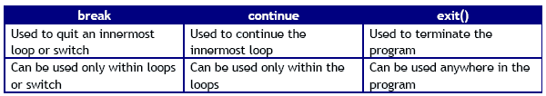
Comparison of break, continue and exit

Slide 74
Conditional Expression Operator (?:)
Syntax
exp1 ? exp2 : exp3
Arguments
exp1, exp2, and exp3 Any expression.
goto
Syntax
goto label;
Arguments
label This is a name or tag associated with an executable statement.

Slide 75
Conditional Expression Operator (cont’d)
return
Syntax
return; /* first form */
return exp; /* second form */
Arguments
exp Any valid C expression.

Slide 76
Practice Programs
if - else statement
1. Create a program that prints a Student is passed(if marks>=40) or failed.
2. Check the entered character whether it is vowel or consonant.
switch statement
1. Check the entered character whether it is vowel or consonant.
2. Write a program that calculates the area of circle, area of triangle, area of square using switch statement.
while loop control structure
1. Write a program that calculates the sum of the digits of a entered number and display the sum.
2. Write a program to print the output like:
* * * * * * * * * * * * * * *

Slide 77
Source code of printing “* “
void main()
{
int i,j;
int space=4;
/*run loop (parent loop) till number of rows*/
for(i=0;i< 5;i++)
{
/*loop for initially space, before star printing*/
for(j=0;j< space;j++)
{
printf(" ");
}
for(j=0;j<=i;j++)
{
printf("* ");
}
printf("\n");
space--; /* decrement one space after one row*/
}
}

Slide 78
Increment or Decrement Operator
What is the output of the following code:
1. int j = 5, k = 5, l = 5, m = 5;
printf("j: %d\t k: %d\n", j++, k--);
printf("j: %d\t k: %d\n", j, k);
printf("l: %d\t m: %d\n", ++l, --m);
printf("l: %d\t m: %d\n", l, m);
2. int i=5;
printf("i++ = %d\ni=%d\n--i=%d",i++,i,--i);

